Slide 1

New Commissioner Orientation – Legislative Overview & CCI Steering Committee Meetings
Kelly Flenniken, Executive Director
January 15, 2025

Slide 2
Agenda
I. Legislative Process
II. Lobbying Tips
III. FYI - Resources
IV. Steering Committee Meetings

Slide 3
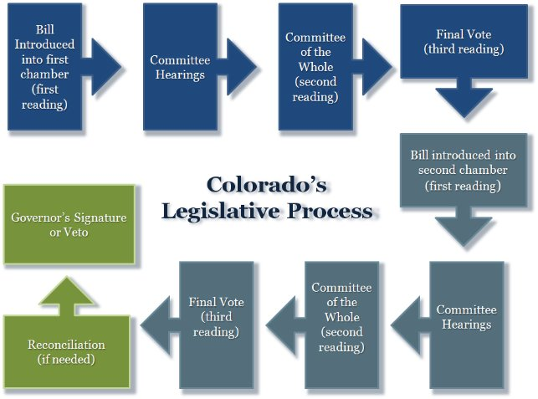

Legislative Process
Notes:
Every red star is an opportunity to vote on the bill

Slide 4
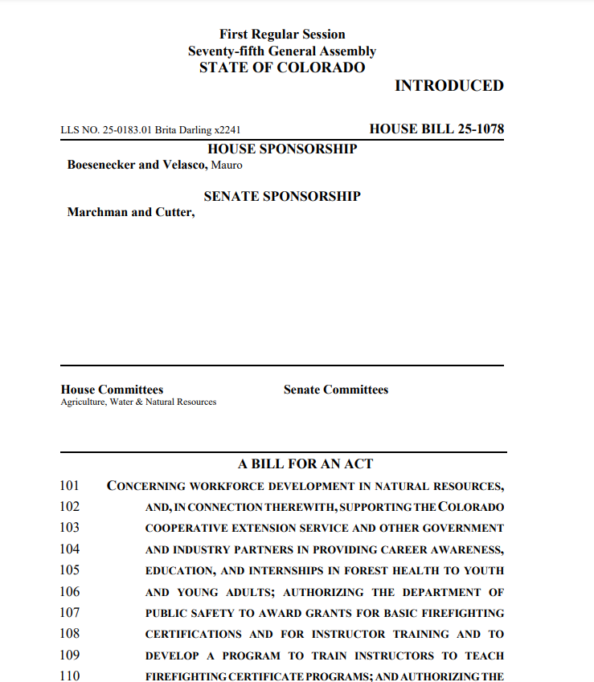
Bill Paper – what am I looking at?
Bill number
sponsors
Committee Assignment
Bill title

Slide 5
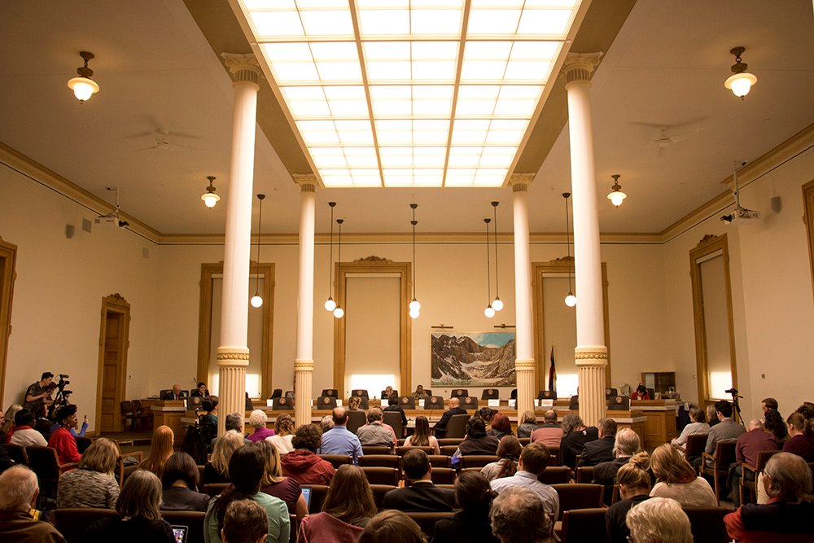
Legislative Process – Committee Hearing
Notes:
In the committee hearing process:
Public testimony is encouraged. CCI will help get you comfortable with testifying either in person or virtually
Committee must vote on the bill for it to be passed out of committee – majority vote, the bill moves forward​
Bill may be amended in committee​
If bill dies – at any stage – it is referred to as ‘postponed indefinitely’ (or PI’d)​
Occasionally, bills are ‘laid over’ if there are lingering questions or votes are missing or a sponsor needs to work on an amendment in order to get it passed​
​

Slide 6
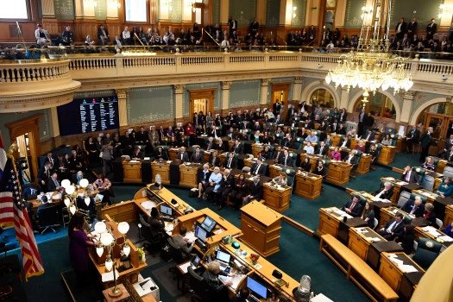
Legislative Process – Committee of the Whole→ Third Reading → move to next Chamber
Notes:
Bill is debated on the floor by entire membership of the House. Amendments may be offered, and ultimately the bill must be voted on either a voice vote, machine or hand count.​
65 house members so the electronic monitor helps with efficiency and accountability when taking a vote.​
​
If the bill passes, it then move on to the next step.
This next step is more of a formality than anything else, but there is still a chance funny business can happen, so don’t get too comfortable. The bill is brought up for the third reading, but not usually debated and any amendments at this step are frowned upon. If passes moves to the Senate for first reading in that chamber
​

Slide 7
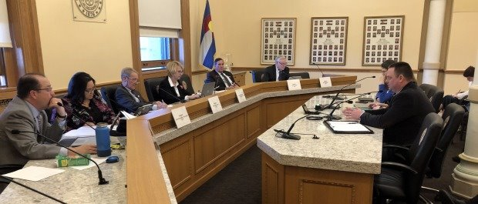
Legislative Process – Committee Hearings
Notes:
Same committee process as previously mentioned…CCI staff will facilitate your testimony
Few things to note:
Be succinct and don’t ramble​
Be prepared to answer all sorts of questions​
Bill are sometimes taking out of order so be patient​
Expect long days​
Additionally, we may ask you to call your member on the committee and express your support or concerns about a bill. Your members want to hear from you!​
One thing I like to remember is, “data makes us credible, stories make us memorable”

Slide 8
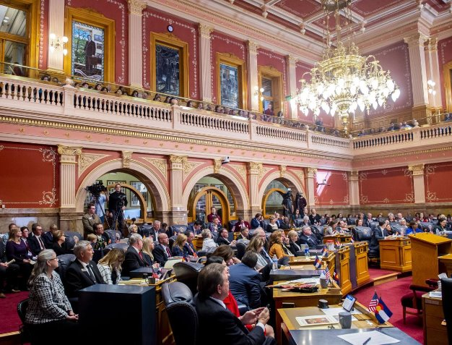
Legislative Process – Committee of the Whole→ Third Reading → move to Governor’s Office
Notes:
​
Bill is debated on the floor by entire membership of the Senate. Amendments may be offered, and ultimately the bill must be voted on either a voice vote or hand count.​
No electronic monitor to record votes in the senate…voting is done with a raised hand.​
Only 35 senators so not too hard to count the yays and nos​
​
If the bill passes, it then moves on to third reading.
Like in the House this is more of a formality than anything else, but we keep focused as funny business has been known to happen.
Bill is brought up but usually not debated and amendments are frowned upon.​
If bill passes, it is then sent to either a conference committee (if amendments on the bill from the two chambers need to be worked out) or directly to the Governor​
​

Slide 9
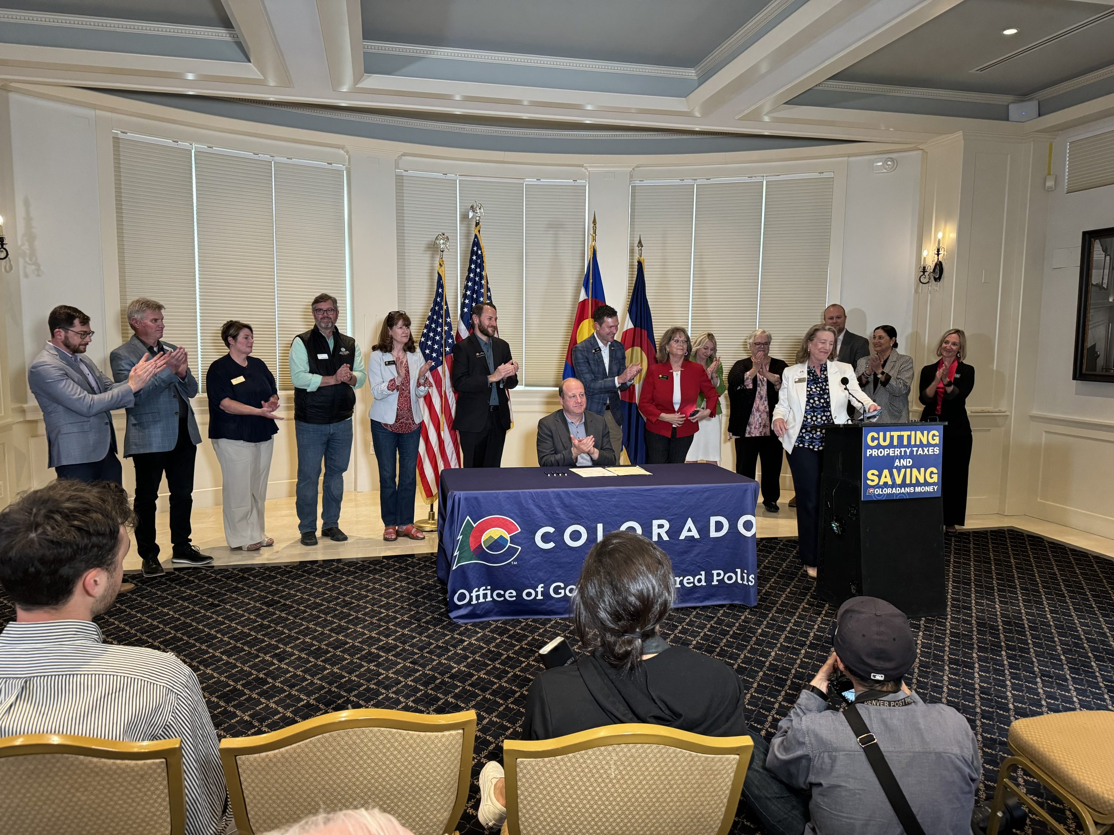
Legislative Process – Governor’s Action(s)
Notes:
The Governor can do one of 3 things:​
Sign it and bill becomes law​
Veto it and bill dies (unless the House and Senate can muster 2/3 vote to override the veto)​
Take no action and bill just becomes law automatically ​- This session the effective date for bills without a safety clause is August 6, 2025
​
Ideally, we’ve reached the end with a signature - Congratulations!
​
​

Slide 10
Tips for Lobbying
Relationships matter – establish/build/maintain relationships with your legislators ASAP
Make effort to meet regularly during session if possible
TESTIFY – your stories are impactful and make a difference
Real world examples – boots on the ground
Communicate EARLY when you have concerns
Notes:
At the end of the day it is important to remember that Legislators are just normal people – their kids and grandkids play soccer, they grocery shop, eat at the same restaurants as you do…see if you can get to know them as people not just policy makers – this will help you connect on a deeper level than simply transactional. This will make it so much easier to explain your position and why you love, or don’t their bill(s)
​
Make sure you know the best way to communicate with your legislators – some prefer phone, email…others like to text or meet in person.
Early communication is so critical – it’s a courtesy to the legislator and early communication also means you’ll have a chance to modify a bill or propose changes. ​
​
Remember, legislators are just like you. They were elected because they wanted to make a change in their communities and that change resonated with voters. As such, they run bills to make those changes. You may not always agree with the bill concept and that’s okay too…as long as you can substantively articulate why, that’s fine. But if you can approach a bill with the mind set of ‘could this be amended to work’ that’s always the right starting spot.
Words of THANKS go a long way

Slide 11
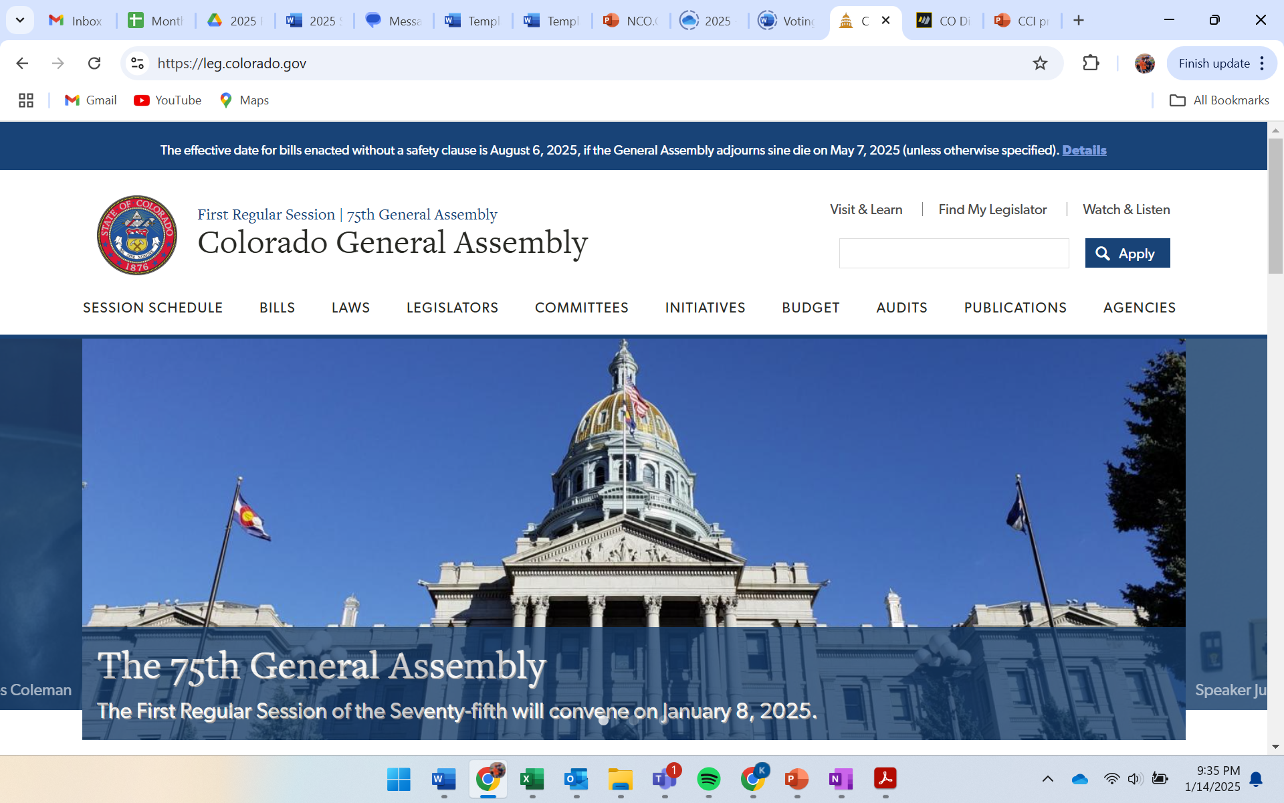
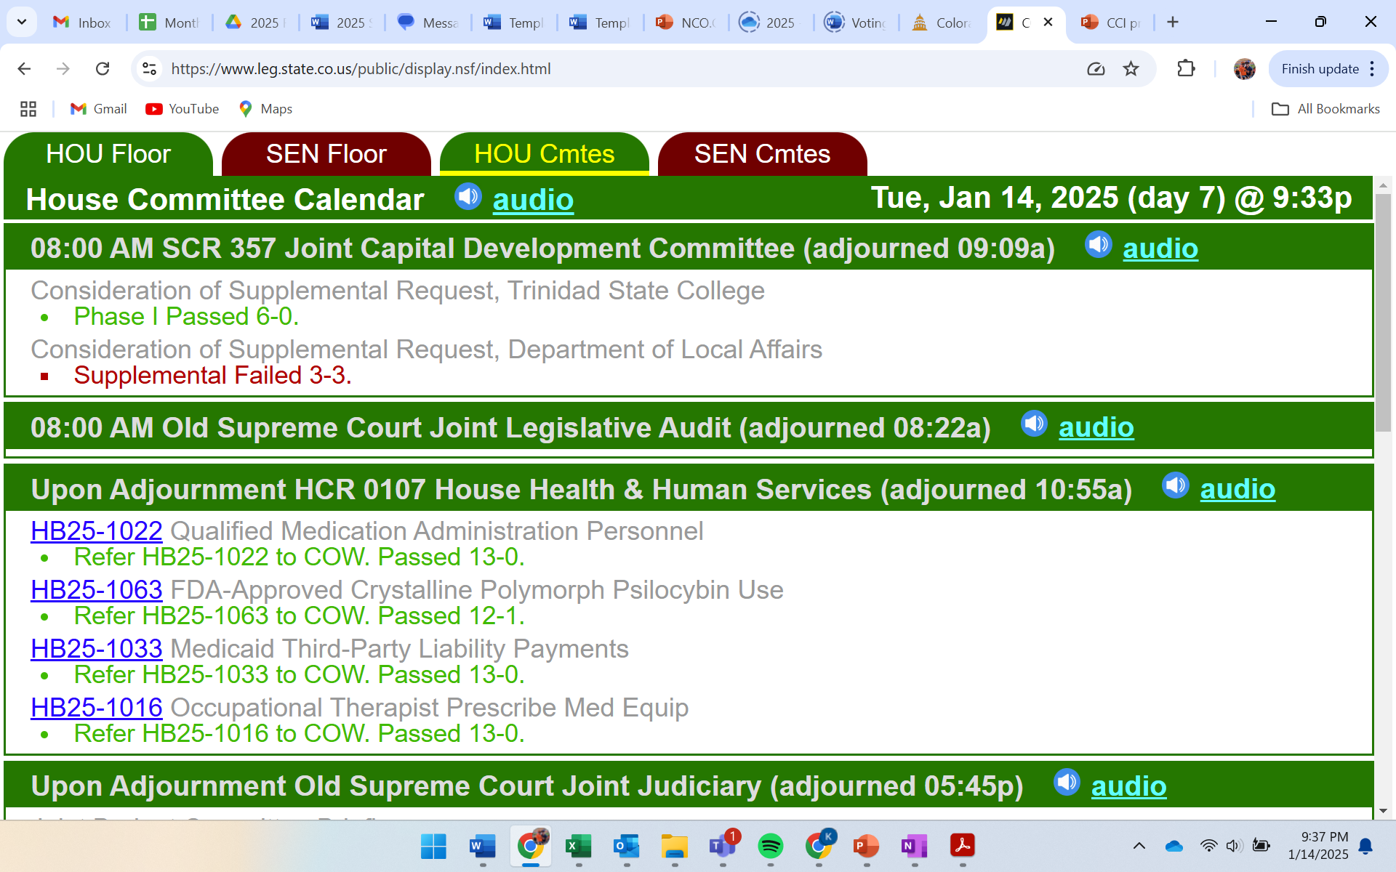
RESOURCES TO REMEMBER
Colorado general assembly website
Display boards
www.leg.Colorado.gov
https://www.leg.state.co.us/public/display.nsf/index.html
Notes:
Stay up to date on all things happening at the Capitol
Watch live testimony
Find bills and their current status
Find your legislator
Schedule
State budget
DISPLAY BOARD – I find this most helpful when I am in person at the Capitol. It updates more frequently and you will see it on several screens in the building

Slide 12
Reagan Shane (Tourism, Resorts and Economic Development “TRED”, Land Use & Natural Resources, Agriculture, Wildlife & Rural Affairs, Public Lands): 303.859.9288
Dylan Peper (Tax & Finance): 303.941.4142
Kevin Neimond (Health & Human Services, Justice & Public Safety): 303.620.6450
Meghan MacKillop (General Government, Transportation & Telecommunications): 720.308.0672
Katie First, Legislative Director
CCI’s Legislative Team
CCI’s Legislative Team
Notes:
The team is here to help.
You won’t interface with Katie too much this session as she is on maternity leave – but she is a key part of our legislative team
​
​

Slide 13
CCI’s Steering Committees

Slide 14









CCI’s Nine Steering Committees
 | Justice & Public Safety |  | General Government |  | Tourism, Resorts & Economic Development
 | Taxation & Finance |  | Transportation & Telecommunication |  | Health & Human Services
 | Land Use & Natural Resources |  | Agriculture, Wildlife & Rural Affairs |  | Public Lands
Notes:
Nine CCI steering committees
All members participate in all committees
Kieran sends invites to all commissioners/proxies to participate – in person or online
We try to send reminders at least one business day in advance
We treat all meetings as public meetings – they are recorded. There is also always a chance that media is present. We will make every effort to let you know that you media is there so you have full awareness.
All names/counties need to be input into Zoom before you are permitted to enter the room – meeting security

Slide 15
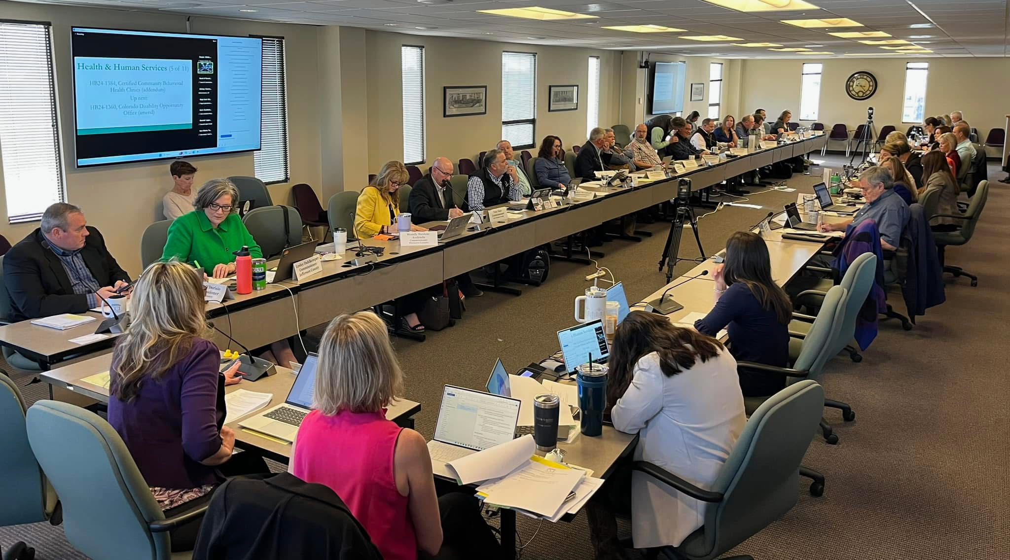
Steering Committee Structure
Notes:
Robert’s Rules
Steering Committees are led by Chairs and Vice Chairs elected for one year stints at a time. In order to be eligible for these positions you must have one year of service as commissioner. We will elect these positions at the steering committee meetings we will have at the end of the month (January 30 and 31)

Slide 16
Steering Committee Process
Hybrid Meetings – each committee runs back to back over the course of two days
Call to order by Chair
Staff Presents all bills that have been introduced since the last meeting seeking a position from membership (Support, Oppose, Monitor, Amend, No Position)
Participants are encouraged to participate by raising table tents or using the “raise hand” feature on Zoom; or cough loudly on the phone
After discussion, committee Chair will entertain a motion to adopt a position (vote by acclamation, in room/zoom/phone, or roll call) – one county one vote
65% or more to take a position – secret sauce of CCI (everything is bipartisan)
Committee adjourns; next committee convenes
Notes:
Robert’s Rules
How leadership is elected (one full year first)
Steering committee structure

Slide 17
What’s Next?
Steering Committee Briefing Meeting (Virtual Only) – January 24, noon – 1:30pm
January Steering Committee Meetings (Hybrid) – January 30-31, 9am – 4pm
Legislative Breakfast (Capitol, 1st Floor) – January 31, 7:30 – 9:00am
For Zoom information, contact Kieran Boes (kboes@ccionline.org)

Slide 18
Questions?

