Slide 1

County Government 101
CCI Refresher
January 15, 2025
Kelly Flenniken, CCI Executive Director
kflenniken@ccionline.org
970.778.1118 (cell)

Slide 2
Agenda
I. History
II. Role of Counties
III. Emerging Issues
IV. About CCI & Affiliates
V. Q & A

Slide 3
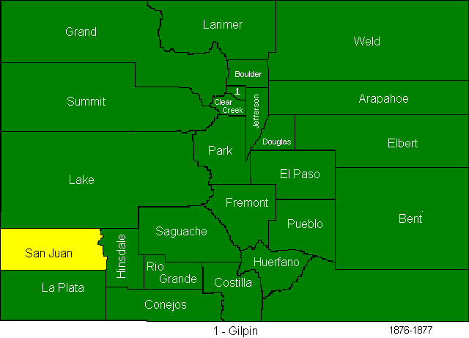
Colorado Counties - 1876
Notes:
Couple of fun facts:
The county form of government predates both the Articles of Confederation and the US Constitution – and has been in effect in America for over 380 years!
The word “County” comes from the English practice of placing each court under the governance of a count.
This English county model was transplanted to American soil and first appeared in Virginia in 1634.
When Colorado was established as a territory in 1861, it had 17 counties. When it achieved statehood in 1876, it had 26 counties. Today it has 64.
Counties are now a common unit of local government across the U.S. - although in Louisiana and Alaska they are called parishes and boroughs, respectively.
There are 3,096 counties in the United States

Slide 4
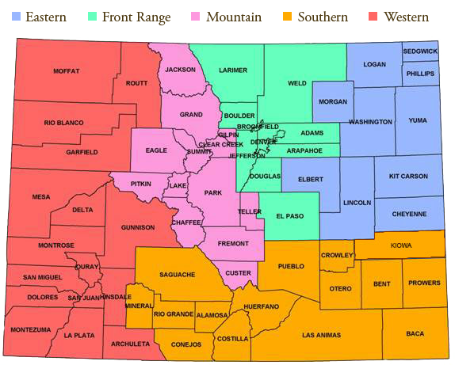
Colorado Counties - 2025

Slide 5

County History, Background, and Facts
Constitutional subdivisions of state government – originally created to carry out the policies and programs of the state
  a LOT has changed in the last 145 years
Counties possess only those powers that are expressly set forth (or necessarily implied) in state statute.
Commissioners are responsible for running the administrative, budgetary, and policy-making functions of the entire county.
County Elected Officials:
  Commissioners
  Sheriff
  Clerk & Recorder
  Treasurer
  Assessor
  Coroner
  Surveyor
  District Attorney
Statutory Roles
Notes:
each of the elected offices has statutory power - the County’s only role is budgetary.
Commissioners have no direct authority over the other elected officials in the county EXCEPT the commissioners approve the budgets for all the other elected officials’ departments.

Slide 6
County Staff
County Manager/Administrator
County Attorney
County Human Services Director
County Road & Bridge Supervisor
County Public Health Director
Notes:
County managers/administrators aren’t required, but currently, 50 of our 64 counties do employ one
CCI loves working with your teams, and I can’t understate the value of this partnership

Slide 7
Role of County Government
Elections
Property assessment and taxation
Human services and public health
Law enforcement and public safety
Courthouses and district attorneys
Motor vehicle - license plates and registration
Road and bridge construction/maintenance
Emergency Management (wildfire, flood, etc.)

Slide 8
Where do counties get their funding?
PROPERTY TAX is a main revenue source for counties
Sales and excise tax authority (general and marijuana)
Fees (Clerk’s Office, Land Use & Development, etc.)
State funding (including HUTF {Highway Users Tax Fund} shareback, human services pass-through and severance tax)
Grants from state and federal agencies (DOLA, CDOT, USDA – Rural Development, etc.)
Federal funds including PILT (payment in lieu of taxes) and SRS (secure rural schools) payments) payments

Slide 9
Responsibilities of Local Governments (A-H)
Agricultural Research & Protection CSU Extension Right to Farm Blowing soils, weeds, and brush Irrigation Districts Predator Control Pest Control Prairie Dog & Rodent Control Noxious Weed Mgmt | Debt for Construction & Maintenance Public Buildings Roads & Bridges
Airports | Drainage Structures & Facilities
Ambulance Service | Emergency Telephone Services (911)
Budgeting & Finance | Employment Issues Policies & Management Insurance Overtime Leave Retirement
Cemeteries | Fire Codes
County Property Management Acquisition Eminent Domain Joint Use w/ Munis | Firearm Regulation
 | Hazardous Waste Incinerator Siting
 | Housing Authorities
Notes:
Programs delegated by the state and executed by counties:
Counties carry out virtually all programs overseen by the Colorado Department of Human Services
General Assistance
Child Welfare Programs
Child Protection
Adolescent Services
Foster Youth in Transition
Core Services to Families Programs
Foster Care Licensing Requirements
Medical Assistance (Medicaid)
Food Assistance/Supplemental Nutrition Assistance Program (SNAP)
Behavioral Health Services
Colorado Works Program
Colorado Child Care Assistance Program (CCCAP)
Old Age Pension
Adult Protection
Low Income Energy Assistance Program - LEAP
Automated Information Systems

Slide 10
Responsibilities of Local Governments
(I-Z)
Improvement Districts Local Improvement Districts Public Improvement Districts | Purchasing
Land Use Management | Roads/Bridges/Transportation
Law Enforcement | Sewage Treatment & Sewers
Libraries | Social / Health & Human Services
Licensing / Regulation Adult Entertainment Auctions Dance Halls Dogs & Pets Escort Services Flea Markets Liquor Marijuana Massage Parlors Pawn Brokers Trash Haulers | Streetlights
Oil & Mineral Rights & Operations | Solid Waste Disposal Siting Dumping/Trash Removal
Parks & Recreation | Underground Utilities
Police Powers (generally) | Water Service
Property Valuation Appeals | Wildfire Planning & Response
Public Health
Notes:
Land use
Comprehensive Plans
Planning documents intended to guide the growth and long-term development of a community
Zoning
Zoning is the process of dividing and classifying land according to its intended use.
The BOCC may provide zoning for all or part of the unincorporated area of the county.
1041 Powers
Allow the board to designate certain areas and activities as being of “state interest” and apply additional regulations to the uses of these lands.
Public Health
Community health status is regularly assessed, and plans are made to improve health;
Infectious diseases are monitored and investigated to prevent their spread;
Children and adults can be vaccinated against disease;
Screening programs are available for early identification of chronic diseases;
Reproductive health services are available;
Health care services are available to all populations within the community;
Emergency response plans are in place for disasters;
Hazards that cause injury or disease are mitigated;
Drinking water is safe;
Air is clean;
Sewage is contained; and
Restaurants serve safe, untainted food.
Jail Facilities
Each county in the state must operate and fund a county jail.
The sheriff is also fire warden for prairie or forest fires in the county.
District Attorney
DA’s appear on behalf of the state for all indictments, actions or proceedings pending in the district court in any county within his/her district. The DA is responsible for reviewing criminal actions or indictments including the enforcement of child support laws.
Emergency Telephone Service (“911”)
Counties may install and operate an emergency telephone service (“911” system).
Fire Codes
Police Powers
Pursuant to C.R.S. §30-15-401, the BOCC may regulate and control the following: Bawdy houses and houses of prostitution; Disturbances and riots; Loiterers and prostitutes; Motor vehicles on public property (except as to speed limits on state highways); Unleashed or unclaimed animals; and Purchase and/or possession of tobacco products by minors
The board of county commissioners has the power to lay out, alter or discontinue any road running into or through the county and to perform such other duties regarding roads as are required by law.
Traffic regulation
regulate parking,
prohibit processions or assemblages on the highways,
create one-way streets and roads,
designate “through” roads,
install stop signs,
designate truck routes,
establish or alter speed limits within limits set by state statutes and
take other actions purely local in nature
Your services are those that are the absolute closest to your constituents – truly where the rubber meets the road. Every day you and your teams deliver critical services to people who don’t even realize they need it until they receive it

Slide 11
Emerging County Issues
Property Taxes
Web Accessibility
Human Services Funding
Housing Affordability
State/County Friction
  Counties lack tools municipalities have
  Philosophical vs. Operational Realities
Notes:
CCAP funding,
CBMS funding and functionality
Local control with land use decisions – It is CCI’s position that land use decisions are best made at the local level and we work very hard to maintain that authority.
Unfunded mandates – always hard to combat, but we are always looking for these and pushing back – especially as we face budget challenges and declining revenues
The CCI team works hard to address these issues every legislative session whether by taking positions on bills, or working to advance something of our own design. This session we are looking at ways to create parity between counties and municipalities when it comes to taxation authority as an example

Slide 12
CCI Support
Source of education tailored to the needs of county commissioners.
Forum for networking with other commissioners, sharing best practices, and taking cooperative action.
Collective county voice at the General Assembly.
Credible source of county information.
Notes:
Whew, that was a lot. Let me try and provide a little comfort and reassurance…the entire CCI team is here to support you throughout your tenure as a county commissioner.
Place to work while you are in Denver – seriously, our offices are always open to you and we love to have you. We will always have a few places where you can plug in and work while you are here, whether a hotel office or a conference room
Peer network – we can help put you in touch with commissioners throughout Colorado who may be experiencing something similar, or have relevant and helpful experience
Research partner – we can work to gather information to help you make decisions or better understand what other counties might be doing
Access – CCI works to connect commissioners to various boards and commissions at both the state and federal levels
Plug survey

Slide 13
About CCI
Formed in 1907, a 501(c)(4) nonprofit corporation
Members consist of entire commissioner boards
Staff works solely for counties
86% of revenues come from county dues
Notes:
Member driven – 65% to take positions

Slide 14
Educate / Advocate / Empower
We work to educate and ensure that commissioners can make informed decisions for their counties and learn from one another.
We strive to protect counties from adverse state and federal policymaking through advocacy.
We seek to empower our members so they can govern effectively and have a voice in the policy affairs that impact their communities.
Notes:
If there really is only one thing you remember from today, let it be this…CCI is here to help. If we don’t know the answer, we will find someone who does.

Slide 15

A 501(c)(3) nonprofit and charitable organization
Membership open to all, the home of our corporate partner program
Focused on educating and assisting county officials and promoting knowledge of and interest in county government
Foundation hosts two conferences each year, various lunch & learns and new commissioner orientation every other year.

Slide 16

An affiliated 501(c)(4) with its own dues structure
Membership based on the presence of public lands in the county
Dues based on federal payment program receipts
Dedicated primarily to federal lobbying on PILT, forest payments, federal lands issues
Maintains a strong presence at the National Association of Counties (NACo)

Slide 17
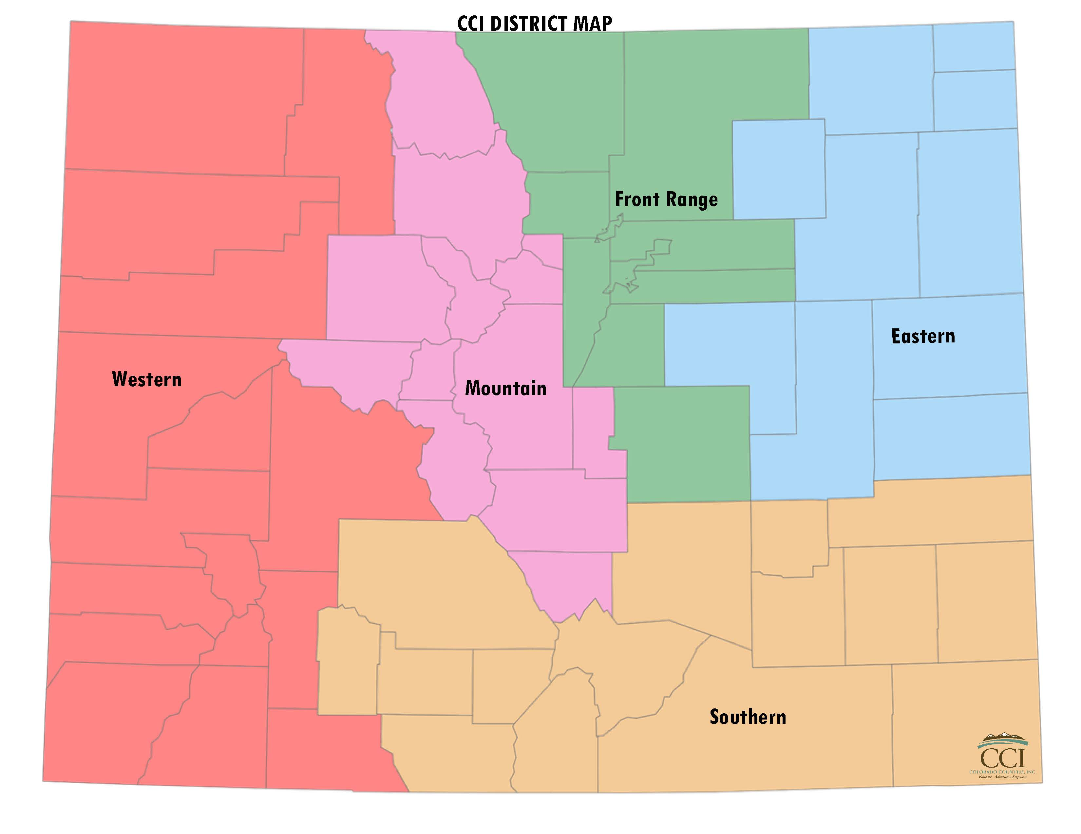
CCI Structure & Governance
Board of Directors – 8 members
  Member from Each District (5)
  Immediate Past President (1)
  Secretary and Treasurer from the over 50,000 Caucus (2)
Board Focus
  Budget and Dues Development
  Administrative Oversight
  Establish Advisory and Ad Hoc Committees
  Amicus Participation
Districts – 5 regions
Elect Board Representatives
Facilitate Regional Dialogue
Bylaws Committee

Slide 18
CCI Steering Committees
Nine Steering Committees - Subject Matter Based
  Agriculture, Wildlife & Rural Affairs,
  Land Use & Natural Resources,
  Transportation & Telecommunications,
  General Government,
  Justice & Public Safety,
  Health & Human Services,
  Tax & Finance,
  Public Lands, and
  Tourism, Resorts & Economic Development
Facilitated by a Chair & Vice Chair
Determine Bill Positions During Session
Recommend County Legislative Priorities
Recommend Policy Statements and Changes
1 county, 1 vote
65% approval threshold

Slide 19
Opportunities for Participation
Legislative Agenda
Policy Statement
District Positions
Meetings
  Steering Committees
  District Meetings
  Conferences
  Workshops and webinars
  Serve as a committee chair or officer

Slide 20
Other Services & Activities
Legislative Representation and Information
Education
  Webinars and workshops
  Initiative Information and Research
  County Operations and Administration
  County Election Data and Ballot Information
Information Sharing and Networking
Appointments to Executive Branch Councils and Commissions
Liaison with Other County-Based Organizations
Off-System Bridge Grant Program

Slide 21
Questions?

